Slide 1
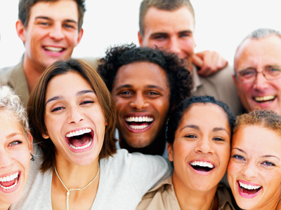

Social Neuroscience
[Professor Name]
[Class and Section Number]
Notes:
Class Recommendations: This lecture framework is based on a 2-class period lesson. It can be condensed into one long lecture period, but this is not recommended because the content may be unfamiliar and difficult for students to understand. Day 1 begins by having students reflect upon their own performance on a social psychology test (the IAT). Next students learn about how social neuroscience uses brain and body measures to understand social behavior. Finally, students learn about EEG and how it can be used to answer research questions about social categorization. This lesson ends with a CAT (Classroom Assessment Technique) that is used to assess student understanding. Day 2 begins with a review of the previous class’s materials (based on the results of the CAT from Day 1). The new content covered for Day 2 is fMRI (and how it can be used to study mentalizing) and neuroendocrinology (and how it can be used to study stress). This lesson also ends with a CAT.
Overview: In this module students learn about what topics are studied in the area of social neuroscience and what kinds of methods are used to address the research questions. Specifically, students learn about how EEG, fMRI, and measurements of stress hormones can be used to help us understand how people think about and reason about other people.
Technical Note: These slides may contain simple click animation so that you can focus students’ attention on a particular question, a selection of text, or an image and not have them be distracted by reading ahead. You can either preview the sequence of animation by going through the slides in slideshow view, visiting the animations tab, or reviewing the slide notes. In the notes you will see a cue - (Click) – that corresponds to each animation.
You may also find hyperlinks to outside videos at various places in the slides. These hyperlinks are embedded in text and indicated by color and in the notes section.

Slide 2
Today’s Learning Objectives
Define social neuroscience and describe its major goals.
Describe how measures of brain activity such as EEG and fMRI are used to make inferences about social processes.
Discuss how social categorization occurs.
Describe how simulation may be used to make inferences about others.
Discuss the ways in which other people can cause stress and also protect us against stress.
Notes:
This slide outlines the learning objectives of the module.

Slide 3
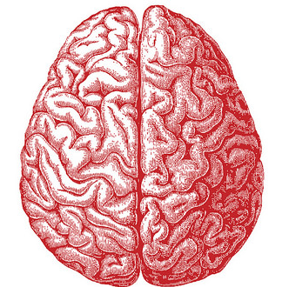
Warm-Up Discussion: IAT
Were you surprised by your results?
How do you think most people would probably score on this test?
What kinds of experiences do you think lead to the formation of implicit attitudes?
What might be done to overcome these automatic responses?
Notes:
The purpose of this slide is to discuss the homework assignment of the Implicit Association Test.
As a homework assignment students should complete the Implicit Association Test: https://implicit.harvard.edu/implicit/takeatest.html
Image: The biases are unconscious and implicit and therefore arise in the brain, this is also a good image to get the students to start thinking about neuroscience and neural processes.
Implicit Association Task (IAT)
• Overview: This activity provides students with an opportunity to participate in a social psychology task that typically reveals unconscious bias. Students are asked to reflect on their performance. This can be used as a jumping off point/example for the kinds of questions social neuroscience attempts to answer and how neuroscience measures can help inform our understanding of social processes.
• Time: 20-30 minutes (including taking the test and discussion)
• Materials: online IAT, which is found at https://implicit.harvard.edu/implicit/takeatest.html
• Directions:
As a homework assignment or during class, have students take an online Implicit Association Test: https://implicit.harvard.edu/implicit/takeatest.html
Have students discuss their results (either in a short reflection paper or in conversation). Possible questions include:
(Click): Were you surprised by your results?
(Click): How do you think most people would probably score on this test?
(Click): What kinds of experiences do you think lead to the formation of implicit attitudes?
(Click): What might be done to overcome these automatic responses?

Slide 4
Overview
What is Social Neuroscience?
Neuroscience of Social Categorization
Neuroscience of Understanding Others’ Minds
Stress & Hormones
Notes:
The purpose of this slide is to provide students with an overview of the material that will be covered during the lecture.

Slide 5
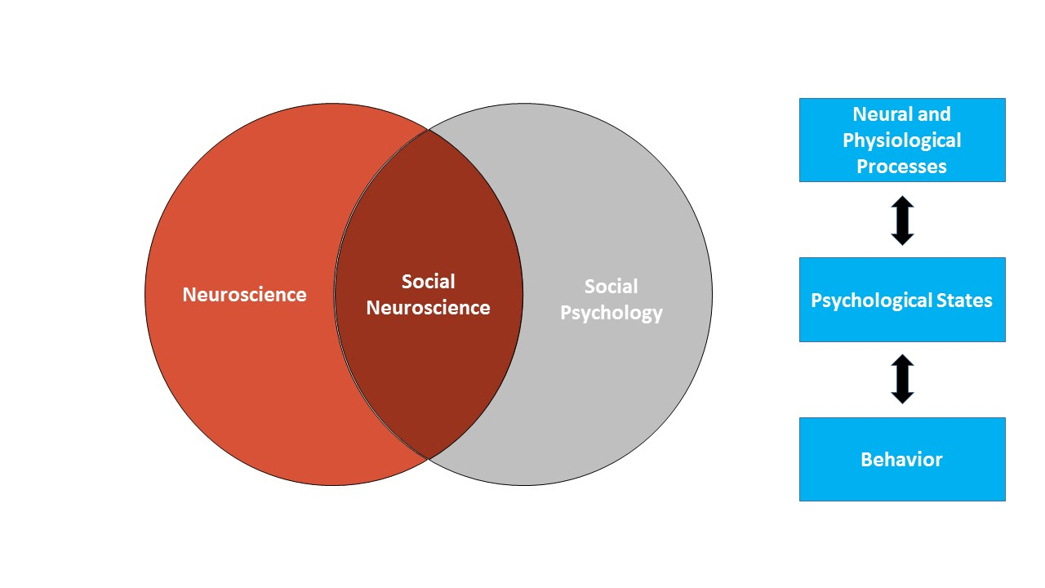
Social Neuroscience
Notes:
The purpose of this slide is to introduce social neuroscience.
Social neuroscience is aimed at understanding the links between the brain, body, and social behavior.
You can think about social neuroscience as the overlap between neuroscience and social psychology: Questions in this field are similar to those of social psychology, but they are addressed through the perspective of neuroscience.
There are three main types of questions that social neuroscientists try to answer:
What can we learn about social behavior when we consider neural and physiological responses?
What are the actual biological systems (e.g., regions of the brain) that execute social behavior?
How are biological systems impacted by social processes?

Slide 6
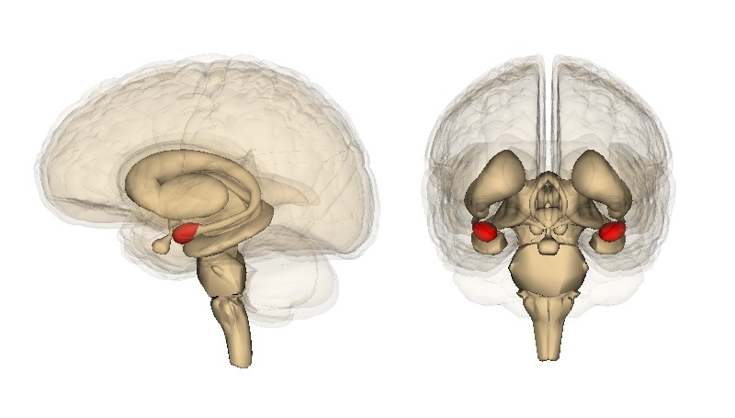
Social Neuroscience Methods
Measuring brain activity
  Electrical activity (EEG)
  Blood flow (fMRI)
Measuring hormones
  Cortisol
Notes:
The purpose of this slide is to continue discussion on social neuroscience and the methods social neuroscientists use in their research.
(Click): Measuring brain activity
There are three main methods that are used in social neuroscience.
(Click): Electrical Activity (EEG)
The first is EEG, which measures electrical activity in the brain.
(Click): Blood flow (fMRI)
The second is fMRI, which measures blood flow in the brain.
(Click): Measuring hormones
(Click): Cortisol
And the third is measuring cortisol (which is a hormone that is released when people feel stress); measuring cortisol helps us understand what triggers people to feel stressed and what can be done to reduce stress.

Slide 7
Overview
What is Social Neuroscience?
Neuroscience of Social Categorization
Neuroscience of Understanding Others’ Minds
Stress & Hormones
Notes:
The purpose of this slide is to provide students with an overview of the material that will be covered during the lecture.

Slide 8
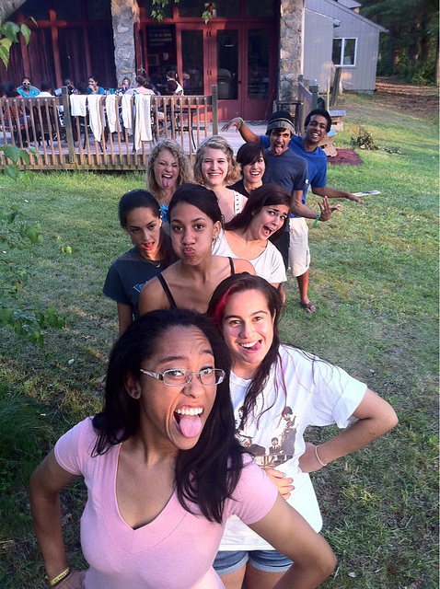
Social Categorization
Mentally classifying someone as belonging to a social group
Stereotypes
  Beliefs about social groups
  Social categorization is first step
Research question: How automatic is social categorization?
Notes:
The purpose of this slide is to introduce the discussion on social categorization.
(Click): Mentally classifying someone as belonging to a social group
Social categorization is the process of thinking about the social group that an individual belongs to (e.g., age, gender, race). Social categorization facilitates quick thinking about other people, but -
(Click): Stereotypes
These quick thoughts can be erroneous (e.g., negative stereotypes about members of different ethnic groups).
(Click): Beliefs about social groups
Social categorization facilitates quick thinking about other people, but these quick thoughts can be erroneous (e.g., negative stereotypes about members of different ethnic groups). It is challenging to study social categorization because people are not always aware if/when they are doing it, and people may be reluctant to report that they are thinking in this way (even if they are aware of it).
(Click): Social categorization is the first step
Psychologists are interested in understanding how automatic socialization processes are, but it can be challenging to study social categorization because people are not always aware if/when they are doing it, and people may be reluctant to report that they are thinking in this way (even if they are aware of it). One way to study social categorization is to measure what is happening in people’s brains when they encounter people from different groups.
(Click): Research question: How automatic is social categorization? → Next Slide

Slide 9
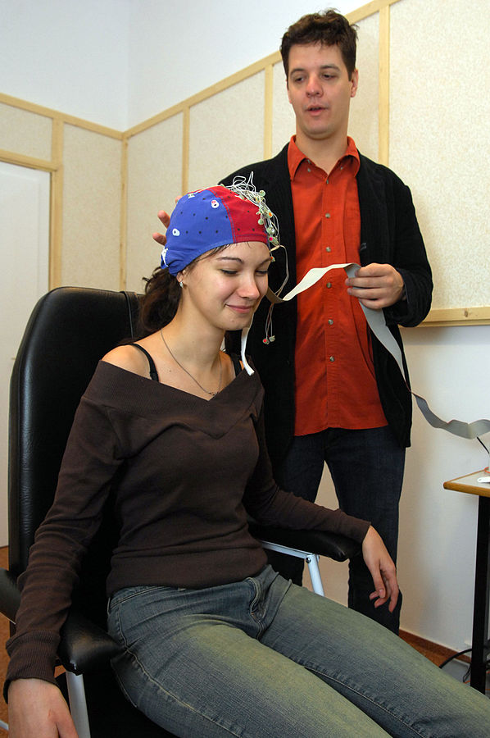
Electroencephalogram(EEG)
A measure of electrical activity (generated by neurons)
Notes:
The purpose of this slide is to introduce the EEG as social neuroscience research method.
(Click): A measure of electrical activity (generated by neurons)
Electroencephalography (EEG) assesses brain activity by measuring the electrical activity produced by neurons (brain cells). To measure the activity of neurons, researchers place a set of electrodes on a participant’s head (often this is done using a cap). The electrodes don’t poke the participant or cause any pain. They simply measure the electrical activity being generated by neurons.
EEG is very good at measuring precise differences in the timing of brain activity. Therefore, it can be used to answer questions about how quickly a type of thinking occurs.

Slide 10



EEG Research on Social Categorization
Method:
  Participants view pictures of people of different social categories
Results:
  Brain activity looks different when viewing members of different social groups
  Apparent at 200ms
  Differences seen even if task is not to categorize
Notes:
The purpose of this slide is to continue the discussion on EEG and it’s use to study social categorization.
Researchers have used EEG to measure how quickly social categorization occurs (by showing pictures of people of different social categories and assessing how quickly changes in brain activity can be detected).
(Click) Method:
The way that they studied this is by showing pictures of people of different social categories (e.g., males vs. females or Blacks vs. Whites) while EEG is being recorded.
(Click) Results:
Brain activity looks different when participants are viewing members of different social groups.
(Click): Apparent at 200ms
The researchers found that brain activity looks different when people are looking at members of different social groups. The difference in brain activity becomes apparent after 200ms (a fraction of a second), showing that social categorization is a very rapid, automatically occurring process.
(Click): Differences seen even if task is not to categorize
Interestingly, differences in brain activity are seen even if people are not directed to pay attention to the social category - so it doesn’t matter if you are trying to socially categorize or not - it just happens automatically.
Ask students questions such as:
What are some implications of these findings for real world?
Now that we know this, what can we do about this?
Use responses to review key concepts.When possible, tie in current events (such as police shootings of Black men in the U.S.) or implications for students (such as future professional interactions with clients, students, or supervisors).

Slide 11

CAT: The Muddiest Point
What was the muddiest point about today’s class?
Write down what concept you are still struggling to understand.
Notes:
Classroom Assessment Technique (CAT): The Muddiest Point
Ask students to write down the “muddiest point” – that is any concept they are still struggling to understand of any questions they still may have about the material. With remaining class time, ask students to share their muddiest point and provide additional review on these points.
Review answers after class and use students’ responses to guide review at the start of class day 2.
If you do not conclude with this Classroom Assessment Technique (CAT), it would helpful to use another CAT. It could be in the form of a:
Muddy point
One-minute paper
Background knowledge
What’s the Principle?
Defining features Matrix:
For more information on CATs click here: http://cft.vanderbilt.edu/guides-sub-pages/cats/

Slide 12
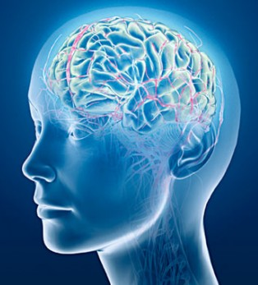
CAT: The Muddiest
Point Review
(add content based on CAT from Day 1)
Notes:
The purpose of this slide is to review the material that was discussed in the previous class session.
Review content from previous lesson based on responses on the CAT (Classroom Assessment Technique).
(Click): Your content here

Slide 13
Overview
What is Social Neuroscience?
Neuroscience of Social Categorization
Neuroscience of Understanding Others’ Minds
Stress & Hormones
Notes:
The purpose of this slide is to provide students with an overview of the material that will be covered during the lecture.

Slide 14
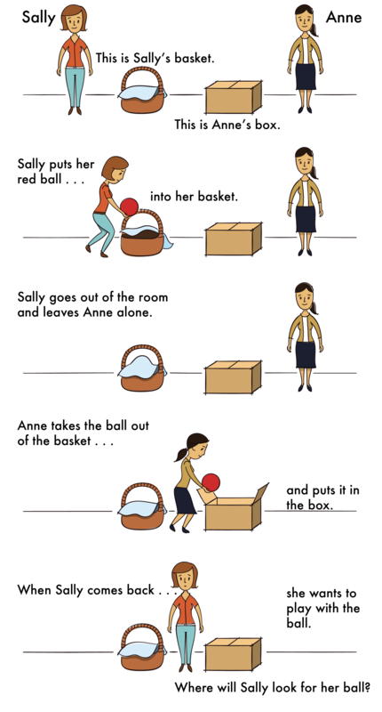
Sally-Ann Task
Developmental Changes in Theory of Mind
Notes:
The purpose of this slide is to introduce the Sally-Ann task to the class.
Students complete Sally-Ann task as an introduction to mental state inference.
The Sally-Ann task measures how well individuals are able to infer the mental states of others. Participants are told the story of Sally and Ann following the prompts written on the picture: This is Sally. This is Sally’s basket. This is Ann. This is Ann’s box. Sally put her red ball into her basket. Then Sally goes out of the room and leaves Ann alone. Ann takes the ball out of the basket and puts it into the box. When Sally comes back she wants to play with her ball. Then tell students that participants are asked the test question: Where will Sally look for her ball? Ask students what is the correct answer to this question (answer: she will look in the basket) and ask them why Sally will do that (answer: because she doesn’t know that Ann moved the ball). Reiterate that this is a test of mental state inference because to answer correctly participants must set aside their own knowledge and answer based on the mental state of the character in the story.
Show video of developmental differences in performance on the Sally-Ann Task: https://www.youtube.com/watch?v=41jSdOQQpv0
After the video, ask students: How do 3- and 4-year-olds approach the task differently? What does this tell us about young children’s ability to infer mental states?

Slide 15
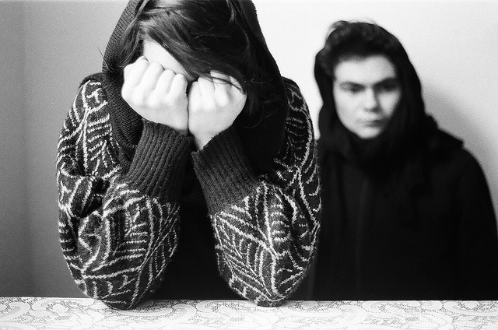
Mental State Inference
Why is mental state inference necessary?
How is this accomplished?
  Simulation hypothesis
Notes:
The purpose of this slide is to begin the discussion on mental state inference and the simulation hypothesis.
(Click): Why is mental state inference necessary?
In social interactions it is important to understand what is going on in the minds of others (e.g., what are they thinking or feeling?).
(Click): How is this accomplished?
(Click): Simulation hypothesis
There has been a debate over how this is accomplished. One hypothesis is that individuals come to understand the minds of others via simulation. If the simulation hypothesis is correct, then individuals should use the same brain regions to think about themselves and to think about others.

Slide 16
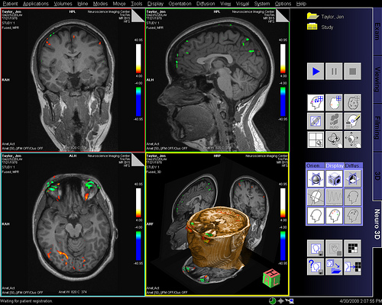
fMRI
Notes:
The purpose of this slide is to continue the discussion on mental state inference and introduce the description of how fMRI research is conducted.
Researchers have used fMRI to test the simulation hypothesis - to see if people are using the same brain regions when they reason about their own mental state and when they reason about the mental states of others. This approach measures changes in the oxygenation of blood to measure brain activity. Participants lay very still while lying inside a powerful magnet. The procedure is noninvasive and does not cause any pain.
This is the way the imaging process is explained in the module: “While EEG measures the brain’s electrical activity, fMRI measures changes in the oxygenation of blood flowing in the brain. When neurons become more active, blood flow to the area increases to bring more oxygen and glucose to the active cells. fMRI allows us to image these changes in oxygenation by placing people in an fMRI machine or scanner (Figure 3), which consists of large magnets that create strong magnetic fields. The magnets affect the alignment of the oxygen molecules within the blood (i.e., how they are tilted). As the oxygen molecules move in and out of alignment with the magnetic fields, their nuclei produce energy that can be detected with special sensors placed close to the head. Recording fMRI involves having the subject lay on a small bed that is then rolled into the scanner. While fMRI does require subjects to lie still within the small scanner and the large magnets involved are noisy, the scanning itself is safe and painless. Like EEG, the subject can then be asked to think about different topics or engage in different tasks as brain activity is measured. If we know what a person is thinking or doing when fMRI detects a blood flow increase to a particular brain area, we can infer that part of the brain is involved with the thought or action. fMRI is particularly useful for identifying which particular brain areas are active at a given point in time.”
The fMRI method is very good at precisely measuring which parts of the brain are used when doing different tasks.
Image: This image is of someone who is actually looking at pictures of faces and the areas that are highlighted in different colors are the areas that are active during that task.

Slide 17
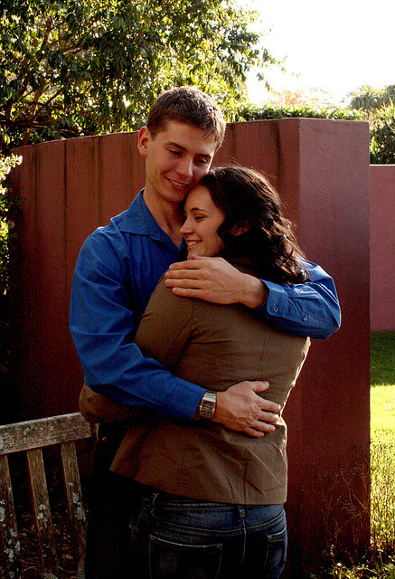
Testing Simulation Hypothesis
Are the same brain regions used for thinking about our own mental states AND thinking about others?
Method (in fMRI scanner):
  Think about yourself
  Think about others
Notes:
This slide continues the discussion of the simulation hypothesis.
(Click): Are the same brain regions used for thinking about our own mental states and thinking about others?
(Click): Method (in fMRI Scanner)
To test the simulation hypothesis, and find out if the same brain regions are used for thinking about our own mental states and for thinking about the mental states of others, researchers placed individuals in the fMRI scanner and gave them two tasks.
(Click): Think about yourself
The first task involved thinking about their own mental state.
(Click): Think about others
The second task involved thinking about other people’s mental states.

Slide 18
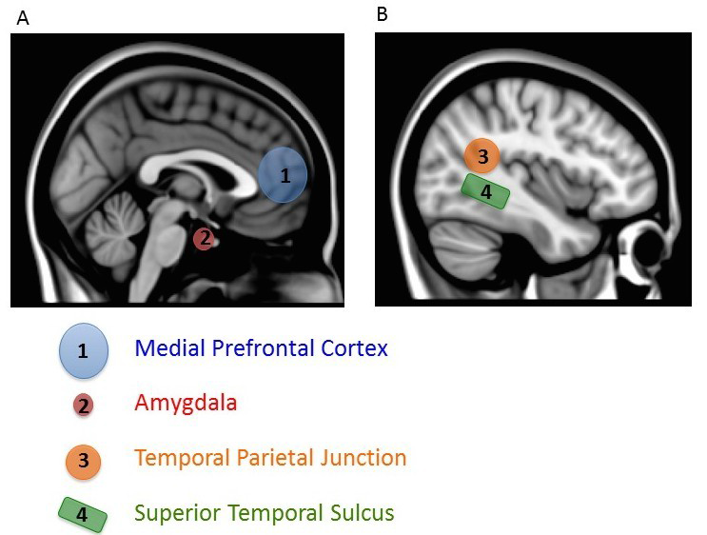
Results
Check your understanding: Explain the findings in your own words.
Notes:
Activity:
Check your understanding: Explain the findings in your own words.
fMRI studies have found that the medial prefrontal cortex (mPFC) is used when thinking about oneself AND when thinking about the mental states of others. Activation in this region is particularly strong when individuals are thinking about the mind of another person who they see as being very similar to themselves. These findings provide support for the simulation hypothesis.
As a review activity: Ask students to explain findings in their own words. Students should write down their answers in their own words, share their findings with a classmate, and then come together in a full class discussion. The instructor should review the results and clear up any misunderstanding as needed.
It should be noted that the mPFC isn’t the only region activated when thinking about others – rather there is a network of brain regions that support social processing.

Slide 19
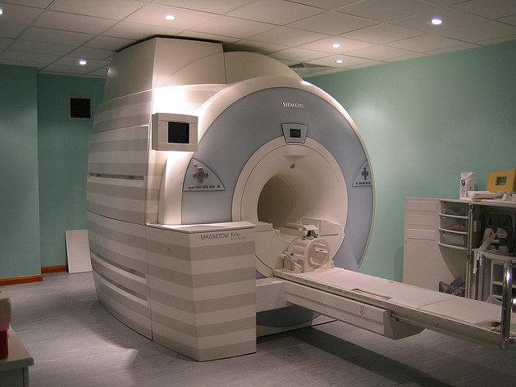
Activity: Design a Social Neuroscience Study
Spend 5 minutes designing a social neuroscience study using fMRI and prepare to give a speech presenting your idea to the class.
Notes:
Activity:
What does stress feel like?
Overview: The purpose of this task is to trigger a stress response in students and have them reflect on what it feels like.
Time: 5 minutes
Materials: None
Directions:
Tell students that they are going to now be asked to give a 1-minute speech to the class about a social neuroscience study that could be done using fMRI and that they will have five minutes to think about their idea and prepare their speech
Then, tell them that you are just kidding – they aren’t going to have to make a speech to the class
Ask by a show of hands, how many people started to feel stressed when they thought about giving a speech.
Use as a jumping off point to talk about stress and stress response

Slide 20
Overview
What is Social Neuroscience?
Neuroscience of Social Categorization
Neuroscience of Understanding Others’ Minds
Stress and Hormones
Notes:
The purpose of this slide is to provide students with an overview of the material that will be covered during the lecture.

Slide 21
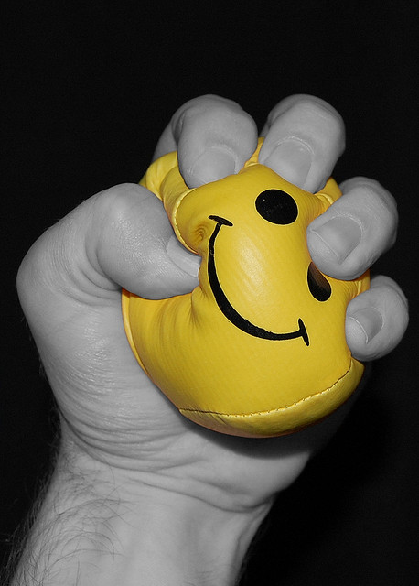
Stress
A threat or challenge to well-being
  Examples of stressors?
Notes:
The purpose of this slide is to begin the discussion on stress and it’s affects on individuals.
(Click): Stress – a threat or challenge to well-being
Stress (broadly a threat or challenge to our well being) comes in many forms, from relatively minor events (such as an exam) to extreme events (such as a natural disaster).
(Click): Examples of stressors?
Ask the students to list examples of stressors.

Slide 22
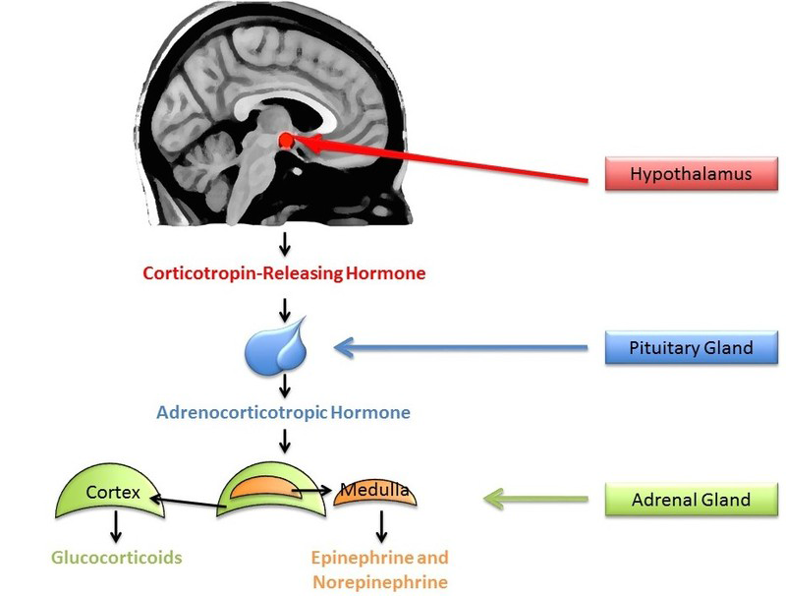
Stress Response
Notes:
This slide continues the discussion on stress and stress response.
Our bodies respond to stressors by activating the sympathetic nervous system (to prepare us to respond to the stressor). As part of this stress response, the HPA axis releases cortisol (a stress hormone).
The release of cortisol serves an important function, as it prepares us to respond to the stressor. However, cortisol can also impair attention, memory, and self-control.
Neuroendocrinology is the study of how the brain and hormones act together to regulate the physiology of the body. This approach can be used to study what causes stress in people and what protective factors might buffer us from stress.

Slide 23
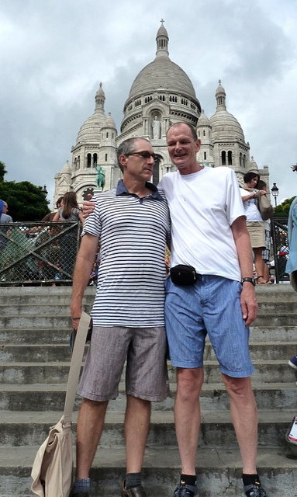
Using Cortisol to Study Stress
Others as a source of stress
  Concern over being evaluated by others
  Interacting with outgroup members
Others as a source of protection from stress
  Social support as a buffer against stress
Notes:
This slide continues the discussion on stress, it’s sources and buffers.
(Click): Others as a source of stress
(Click): Concern over being evaluated by others
Stress hormone levels become elevated when individuals are asked to perform a task in front of others who might judge them (but not individuals performing another random task in the same room). This research shows that fear of judgment by others is a cause of social stress.
(Click): Interacting with outgroup members
Other research has found that interacting with members of an “outgroup” (a social group that one does not belong to) can lead to increased stress.
(Click): Others as a source of protection from stress
(Click): Social support as a buffer against stress
Interestingly, the presence of others can be a protective buffer against stress: people who have greater social support networks show less of an increase in stress hormones when faced with a stress-inducing situation (giving a speech in front of evaluators).
Image: Receiving social support.

Slide 24
Defining Features Matrix:
Social Neuroscience Methods
 | Is this true of EEG? | Is this true of fMRI? | Is this true of neuroendocrine measures?
Measures which regions of the brain are active
Informs researchers about how the brain influences social behavior
Uses hormones to measure stress levels
Measures the timing of neural responses
Painless to administer
Informs researchers about how the brain responds to social information
Notes:
Activity:
Print out slide to use as a handout. Have students identify which statements are true of each type of method. Use remaining class time to discuss responses and review answers

Slide 25
Photo Attribution
Slide 1 | Photo Credit: Closeup portrait of a group of business people laughing Richard foster https://www.flickr.com/photos/93963757@N05/8551937456 https://creativecommons.org/licenses/by-sa/2.0/
Slide 3 | Photo Credit: brain picture Allan Ajifo https://www.flickr.com/photos/125992663@N02/14599057094/ https://creativecommons.org/licenses/by/2.0/
Slide 6 | Photo Credit: Amygdala Life Science Databases(LSDB) https://en.wikipedia.org/wiki/Amygdalofugal_pathway#/media/File:Amygdala.png http://creativecommons.org/licenses/by-sa/2.1/jp/deed.en
Slide 8 | Photo Credit: Day 19.07 double G's Frerieke https://www.flickr.com/photos/9399948@N05/5956599974/ https://creativecommons.org/licenses/by-nc/2.0/
Slide 9 | Photo Credit: Institut of Psychology Szeged EEG Laboratory 3 Pataki Márta https://commons.wikimedia.org/wiki/File:Institut_of_Psychology_Szeged_EEG_Laboratory_3.jpg#/media/File:Institut_of_Psychology_Szeged_EEG_Laboratory_3.jpg http://creativecommons.org/licenses/by-sa/3.0/
Slide 10 | Photo Credit: africa, african, black, care, cheerful, clinic, doctor, www.audio-luci-store.it https://www.flickr.com/photos/audiolucistore/15633607954 https://creativecommons.org/licenses/by/2.0/ Photo Credit: Testimonial1 herlitz_pbs https://www.flickr.com/photos/herlitzpbs/6306006014/ https://creativecommons.org/licenses/by-nd/2.0/ Photo Credit: museum tour guide picture www.audio-luci-store.it https://www.flickr.com/photos/audiolucistore/11047195513/ https://creativecommons.org/licenses/by/2.0/
Slides 11&12 | Photo Credit: Illustrated silhouette of a black cat nehtaeh79 http://www.freestockphotos.biz/stockphoto/16624 http://creativecommons.org/publicdomain/zero/1.0/
Slide 12 | Photo Credit: digital-drugs-binaural-beats digitalbob8 https://www.flickr.com/photos/44568283@N02/4097561067 https://creativecommons.org/licenses/by/2.0/
Slide 15 | Photo Credit: Untitled Rowena Waack https://www.flickr.com/photos/12356241@N03/5297559184/ https://creativecommons.org/licenses/by-nc-nd/2.0/
Notes:
Photo Attribution Slide

Slide 26
Photo Attribution
Slide 16 | Photo Credit: Jen's Brain (Doesn't it look smart?) Andy Carlson https://www.flickr.com/photos/53535391@N00/2469630798/ https://creativecommons.org/licenses/by-nc-sa/2.0/
Slide 17 | Photo Credit: Mount Tomah Botanical Gardens - Stephen and Tahn (May 2009) Marley Cook https://www.flickr.com/photos/39528050@N07/3716674529/ https://creativecommons.org/licenses/by/2.0/
Slide 19 | Photo Credit: 01 Siemens MAGNETOM Trio Image Editor https://www.flickr.com/photos/11304375@N07/3081315619 https://creativecommons.org/licenses/by/2.0/
Slide 21 | Photo Credit: stress bottled_void https://www.flickr.com/photos/22964099@N05/2204059683 https://creativecommons.org/licenses/by/2.0/
Slide 23 | Photo Credit: Paris_MontmartreBasillica.JPG Ed and Eddie https://www.flickr.com/photos/edandeddie/10340299033/ https://creativecommons.org/licenses/by-sa/2.0/
Notes:
Photo Attribution Slide

